Slide 1
Catching Social Media Advertisers with Strategy Analysis
Meng Jiang
University of Illinois at Urbana-Champaign
www.meng-jiang.com
The First International Workshop on Computational Methods for CyberSafety

Slide 2
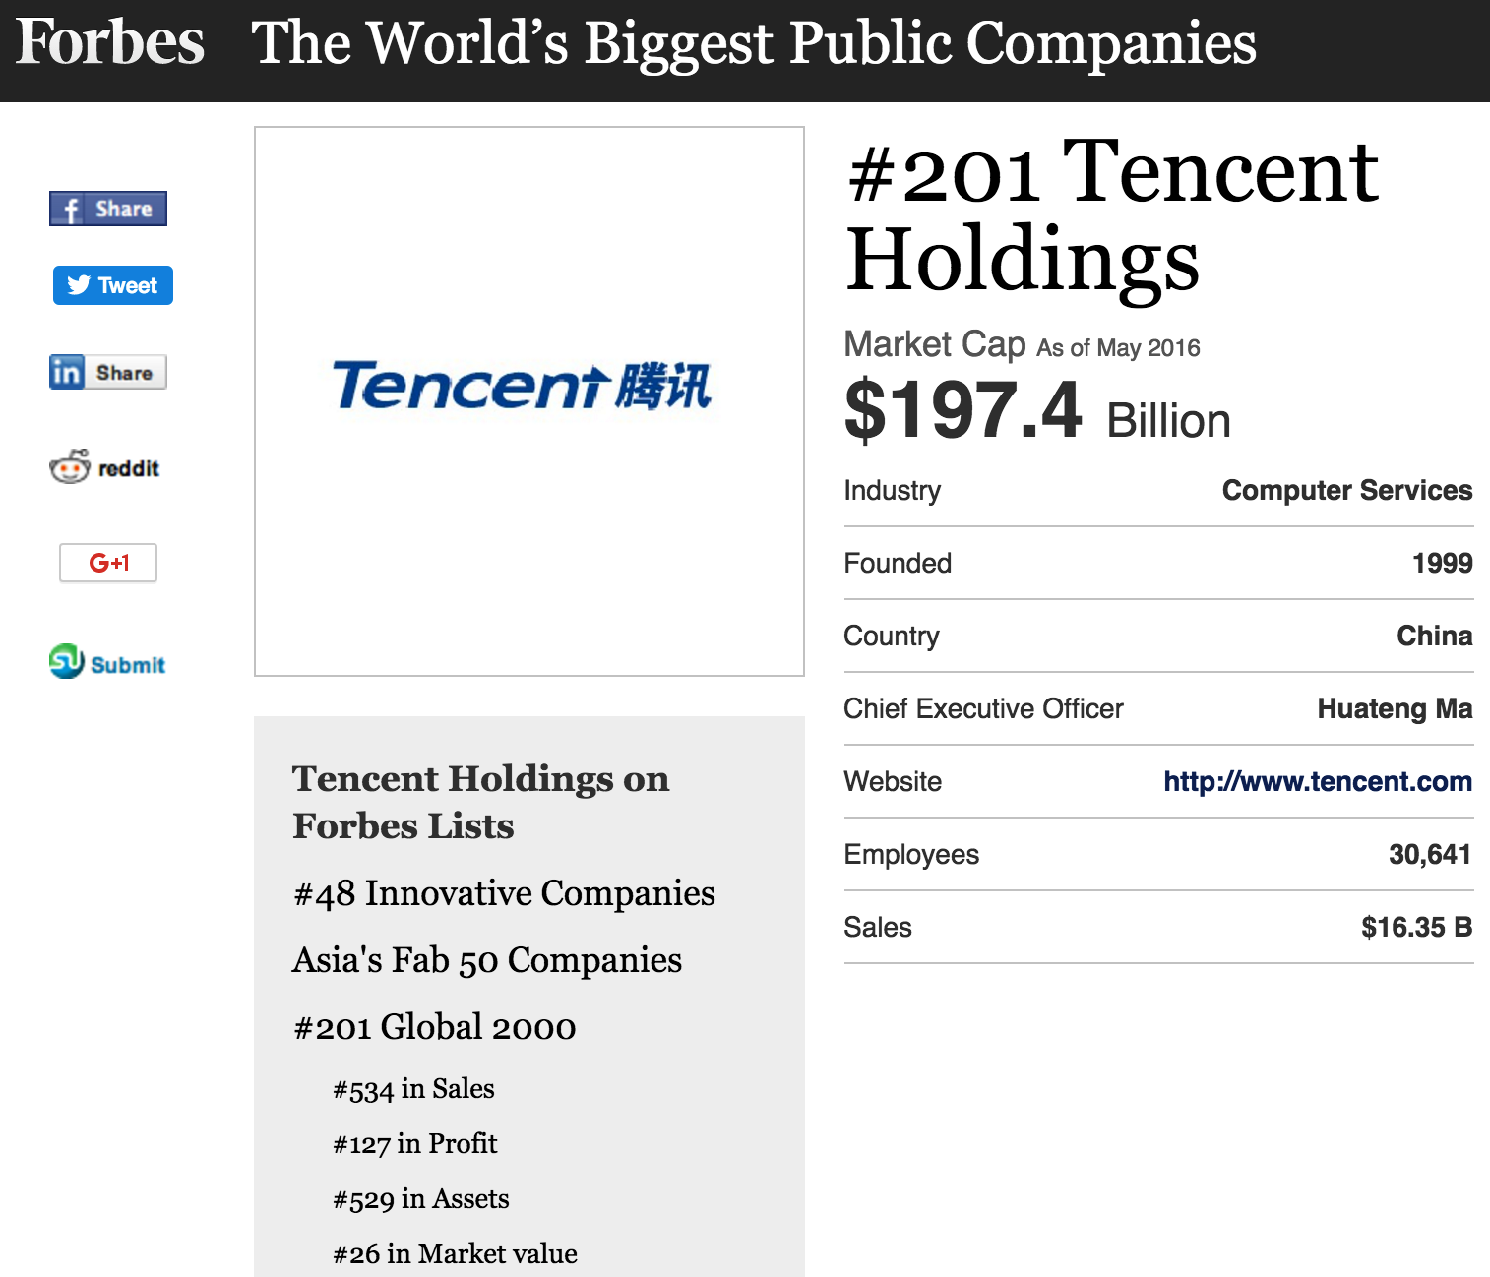
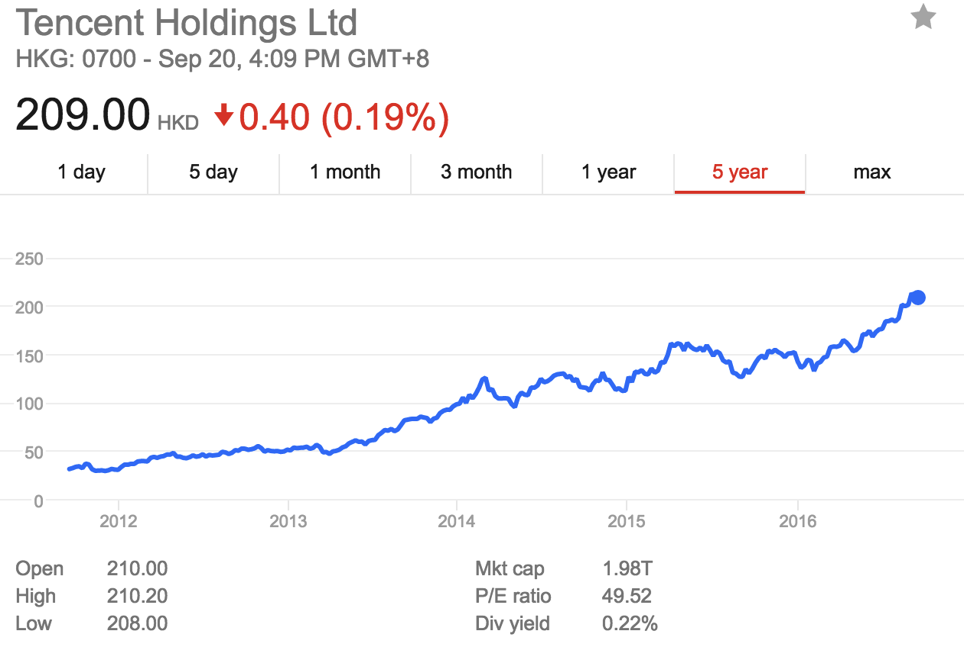
Advertisers: It’s not a CyberSaftey issue?
Tencent

Slide 3
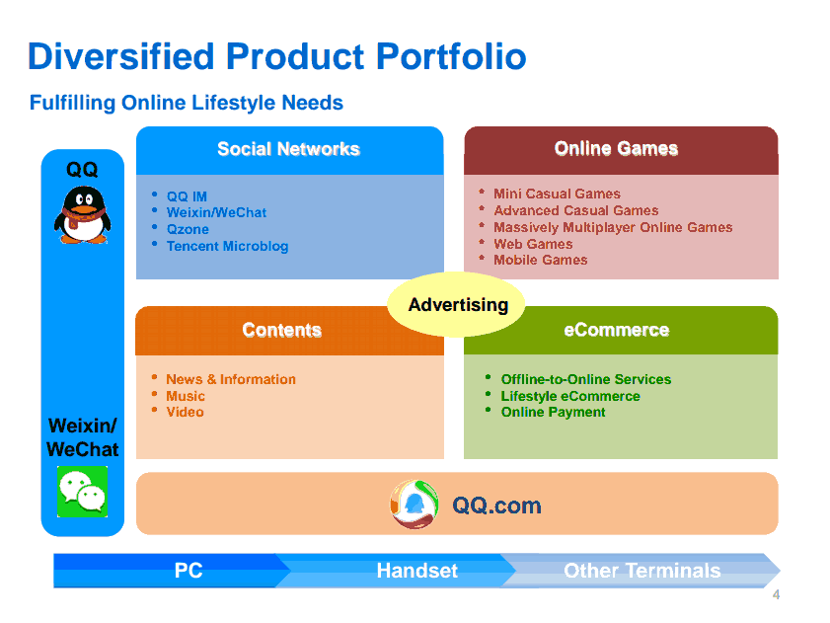

Slide 4
Advertisers: It’s not a CyberSaftey issue?
NSFC Project (2011-) between Tencent and Tsinghua Univ.
Tencent Weibo in 2011 told us
Low conversion rate (< 6%): #retweets per feed request
“I want a tweet recommender system!”
M. Jiang, P. Cui, R. Liu, Q. Yang, F. Wang, W. Zhu and S. Yang. “Social Contextual Recommendation” in CIKM’12. (cited by 149)
Deployed in Weibo News Feed, 2012. Improved conversion rate from 5.78% to 8.27% (relatively 43%).
Tencent Weibo in 2013 told us
A more serious problem: zombie followers

Slide 5

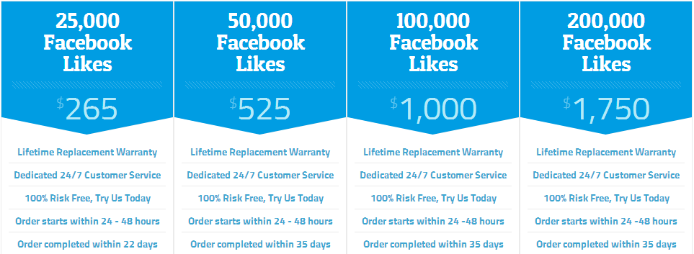
Advertisers: It’s not a CyberSaftey issue?
×
Experience-driven approaches: features of #followees, #hashtags, #URLs…

Slide 6
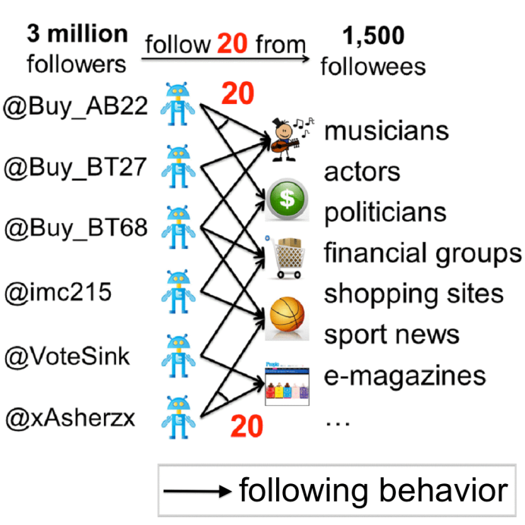
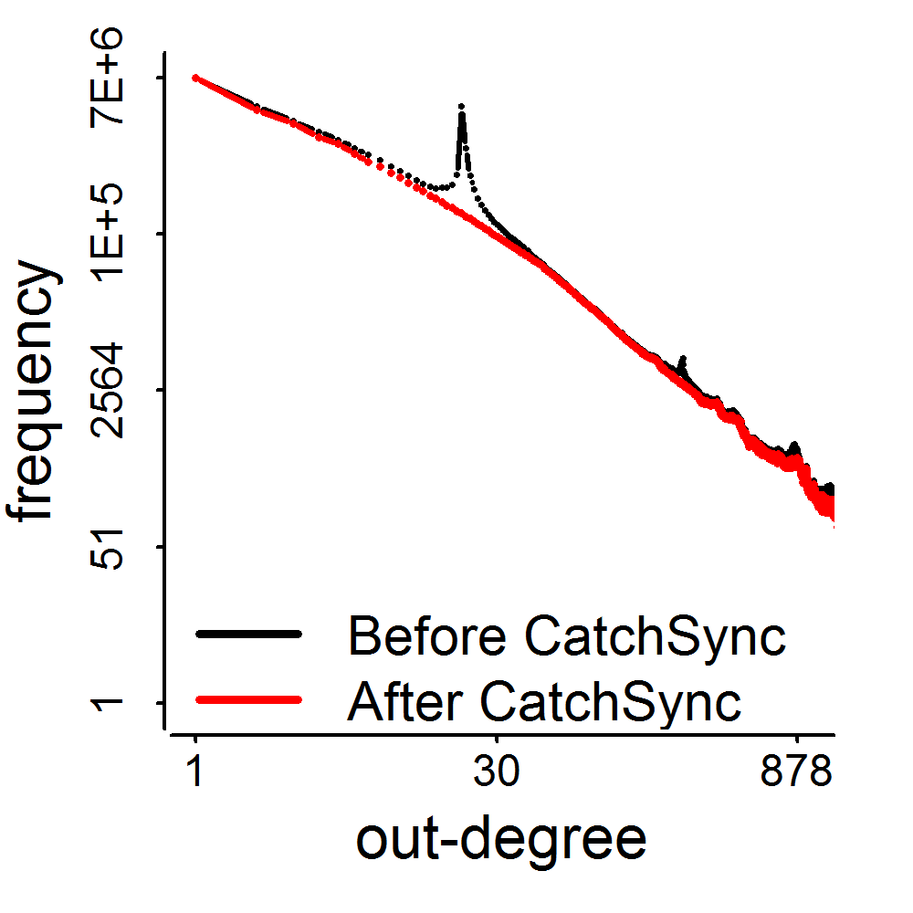
Advertisers: It’s not a CyberSaftey issue?
M. Jiang, P. Cui, A. Beutel, C. Faloutsos and S. Yang. “CatchSync: Catching Synchronized Behavior in Large Directed Graphs” in KDD’14 Best Paper Finalist. (#citations = 36)
Deployed in Weibo? Unfortunately, in July 2014…

Slide 7
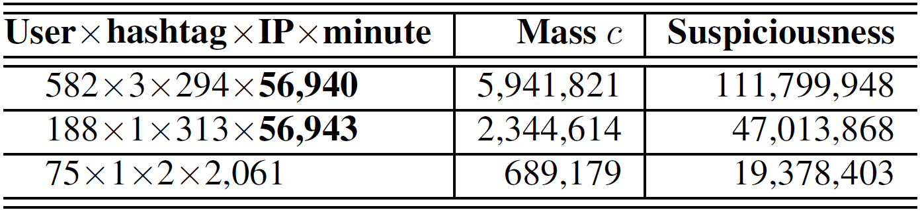
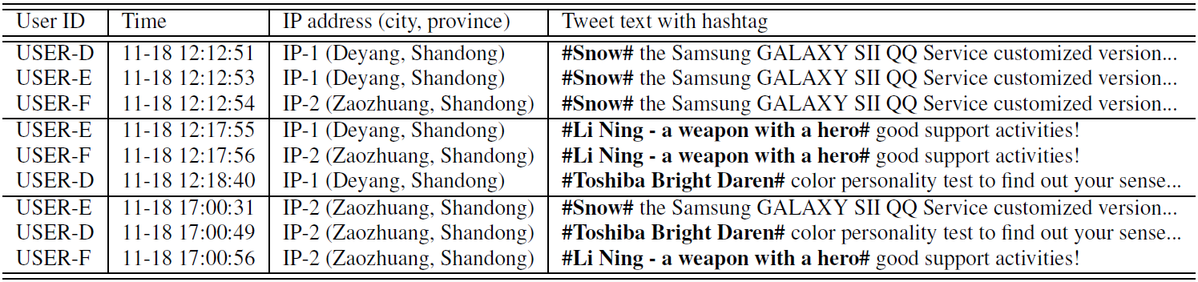
Advertisers: It’s not a CyberSaftey issue?
M. Jiang, A. Beutel, P. Cui, B. Hooi, S. Yang and C. Faloutsos. “A General Suspiciousness Metric for Dense Blocks in Multimodal Data” in ICDM’15.

Slide 8
Advertisers: It’s not a CyberSaftey issue?
It’s really a CyberSafety issue! It can even dismiss your department/company.
Q1: What are the advertising strategies? Are they new? Are they different?
Q2: Can we detect the botnet advertisers (spammers) that were set up by the marketers?

Slide 9
Comparing Social Media Advertising and Traditional Advertising: S1

Slide 10
Comparing Social Media Advertising and Traditional Advertising: S2

Slide 11
Comparing Social Media Advertising and Traditional Advertising: S3

Slide 12
Comparing Social Media Advertising and Traditional Advertising: S4

Slide 13
Solution 5: Synchrony Strategies in Social Media

Slide 14
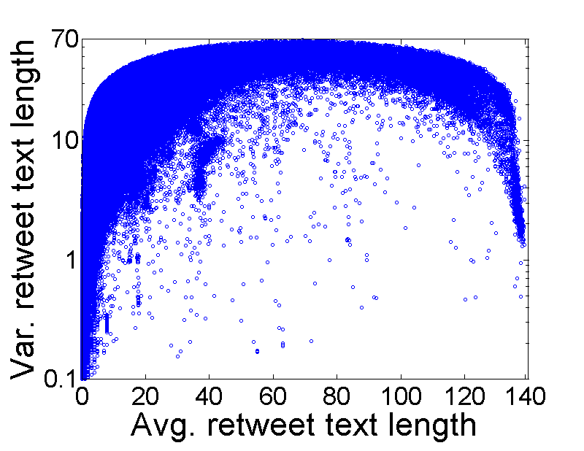
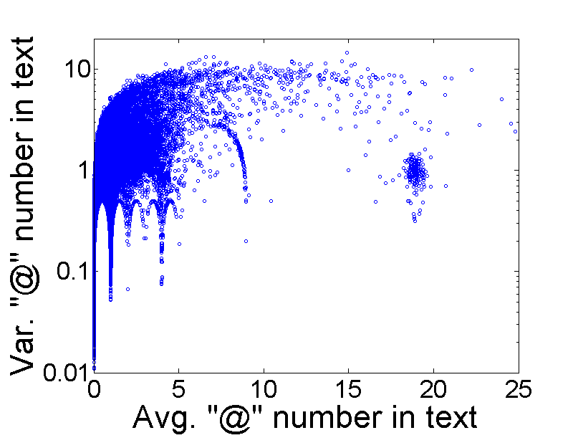
Observation: Features
Comment features and mentioning features
Every dot is a user

Slide 15
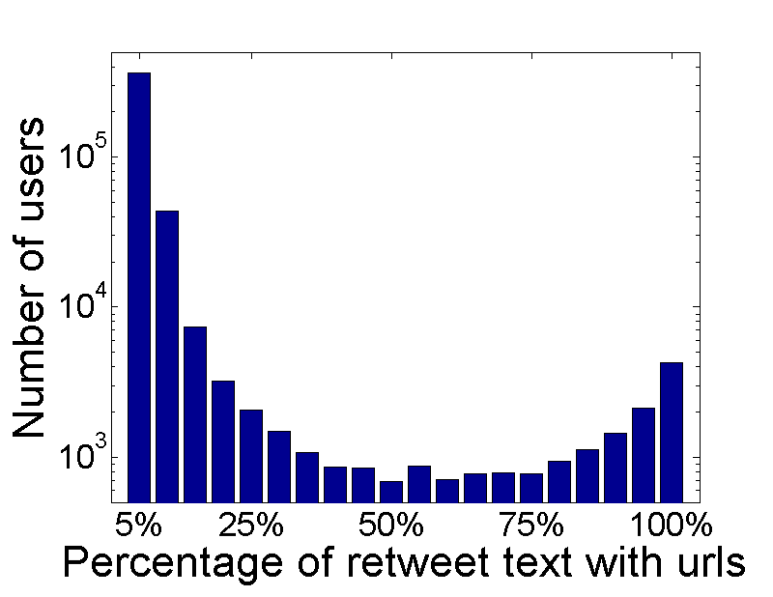
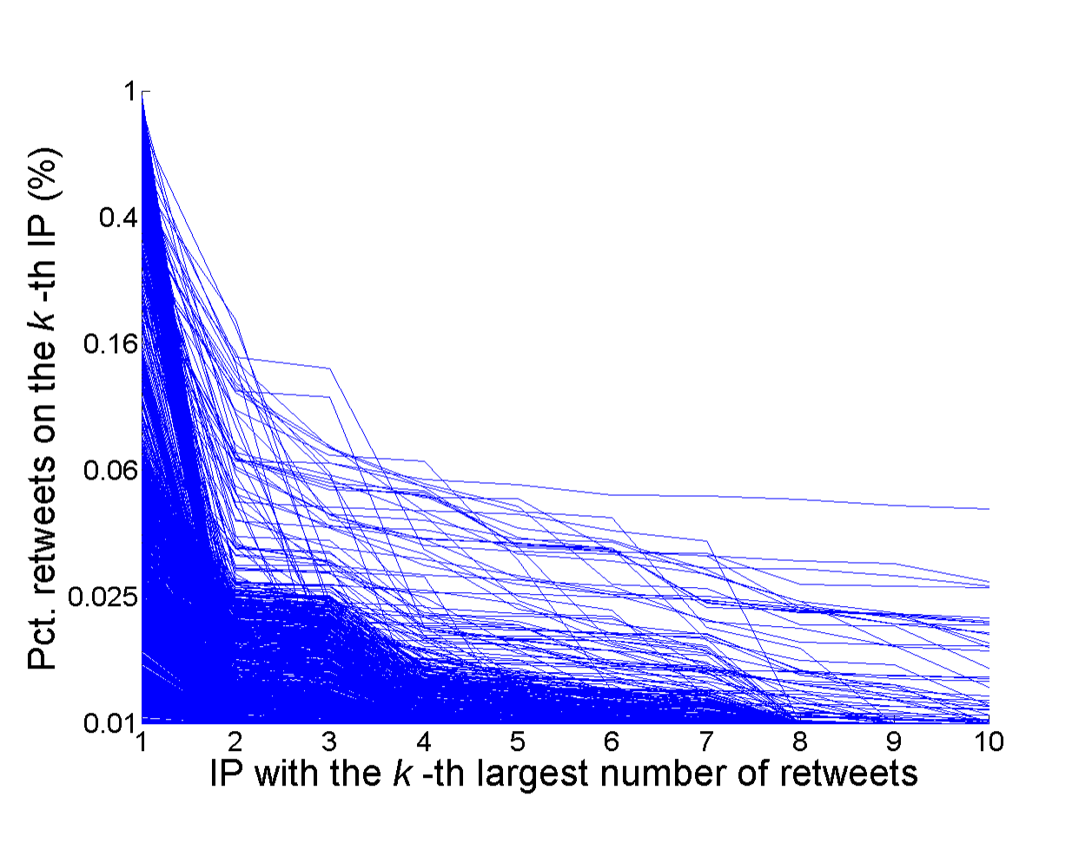
Observation: Features
URL features and Device features

Slide 16
Observation: Features
Lockstep behavioral features

Slide 17
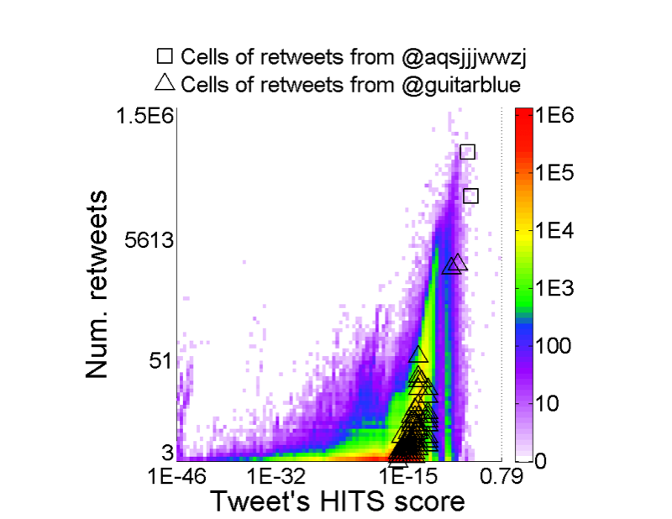
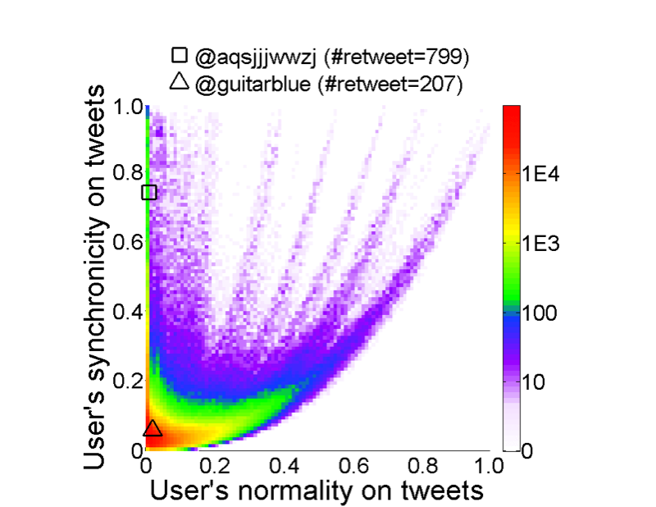
Observation: Features
Message synchrony [CatchSync, KDD’14]

Slide 18
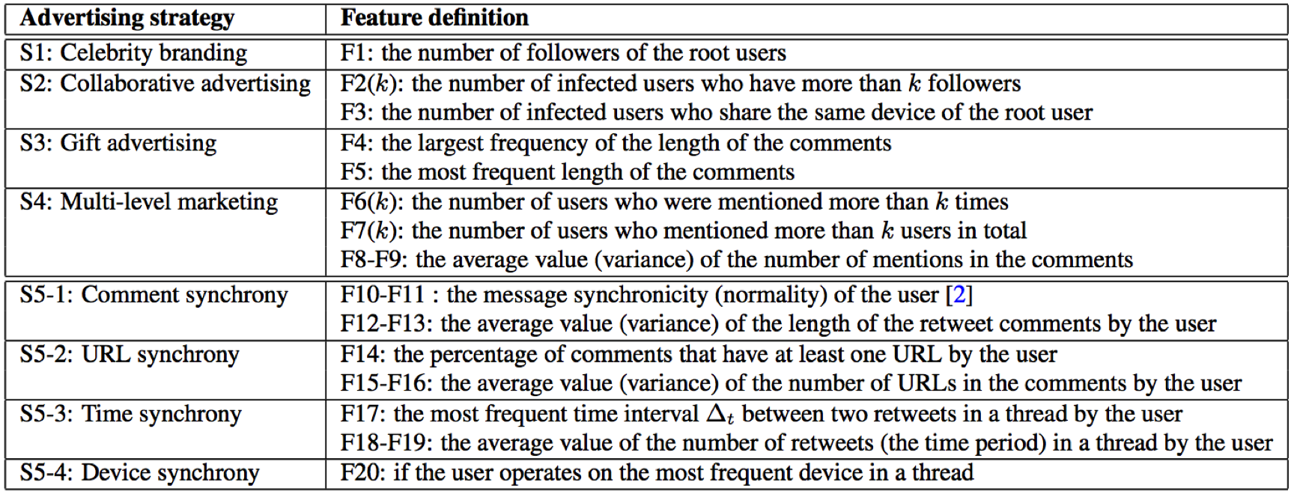
Modeling: Features

Slide 19
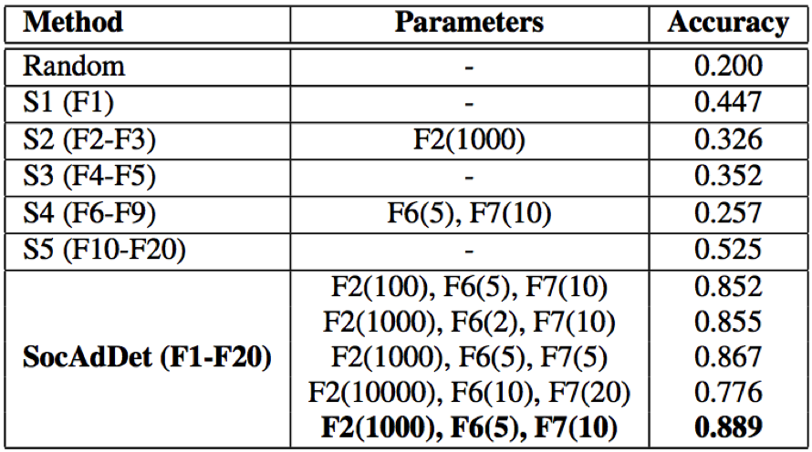
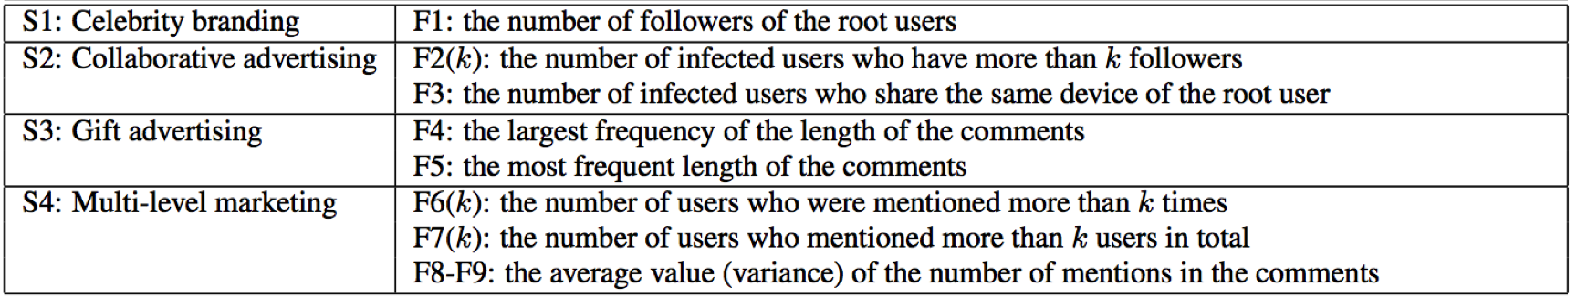
Experimental Results
T1: Which strategy the tweet used? 5-class classification.

Slide 20
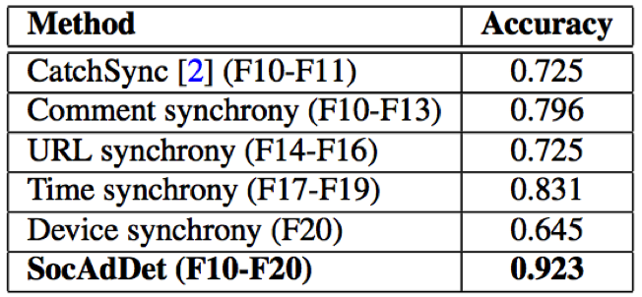
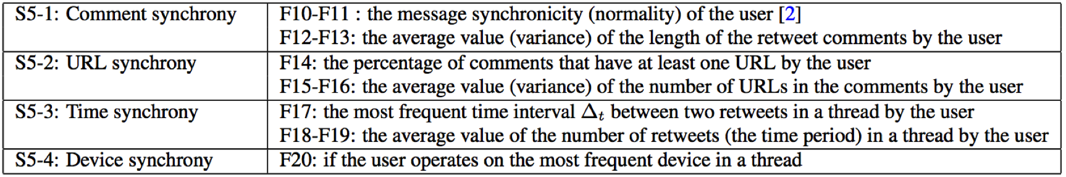
Experimental Results
T2: Detecting botnet advertisers (spammers in synchrony): binary classification.

Slide 21
Summary
Comparing social media advertising strategies and traditional (old-school) strategies
Celebrity branding
Collaborative advertising
Gift advertising
Multi-level marketing
Synchrony (social media botnet)
Strategy classification: 0.889
Spammer detection: 0.923
Hope your company can avoid Weibo’s misfortune.

Slide 22
Thank you!
Catching Social Media Advertisers with Strategy Analysis

